Slide 1
Table of specification
February 6, 2023
Tadian, Mt. Province
Notes:
This template can be used as a starter file for presenting training materials in a group setting.
Sections
Sections can help to organize your slides or facilitate collaboration between multiple authors. On the Home tab under Slides, click Section, and then click Add Section.
Notes
Use the Notes pane for delivery notes or to provide additional details for the audience. You can see these notes in Presenter View during your presentation.
Keep in mind the font size (important for accessibility, visibility, videotaping, and online production)
Coordinated colors
Pay particular attention to the graphs, charts, and text boxes.
Consider that attendees will print in black and white or grayscale. Run a test print to make sure your colors work when printed in pure black and white and grayscale.
Graphics, tables, and graphs
Keep it simple: If possible, use consistent, non-distracting styles and colors.
Label all graphs and tables.

Slide 2
Objectives
1. Explain TOS 2. Prepare 3rd Quarter TOS
Notes:
Give a brief overview of the presentation. Describe the major focus of the presentation and why it is important.
Introduce each of the major topics.
To provide a road map for the audience, you can repeat this Overview slide throughout the presentation, highlighting the particular topic you will discuss next.

Slide 3
Table of Specification
A table of specifications (TOS) is a chart that teachers and test developers use in item writing. It ensures that the test developed assesses the content taught ...
It is an assessment of learning.

Slide 4
Purpose of Table of Specification
The purpose of a Table of Specifications is to identify the achievement domains being measured and to ensure that a fair and representative sample of questions appear on the test.

Slide 5
Steps in preparing TOS
Determine the coverage of your exam
Determine the competencies for each topic
Determine the duration per competency
Determine the Cognitive Process Dimension where the competency falls

Slide 6


Slide 7
Redeployment of Teachers
Name of Teacher | Address | Former Station | New Station
Paulo, Aurea | Kayan, Tadian | Lubon NHS | Tadian SAT
Calang-ad, Tulning Joy | Sagada | Otucan-Bila NHS | Lubon NHS
Pil-ingen, Evelyn A. | Lubon, Tadian | Masla, Tadian | Lubon NHS
Montilla, Vina | Masla, Tadian | Mt. Data NHS | Masla NHS

Slide 8


Slide 9


Welcome

Slide 10
Today’s Overview
1
2
Explore your new environment
3
Meet your new colleagues
Familiarize yourself with your new assignment
Notes:
This is another option for an overview slide.

Slide 11
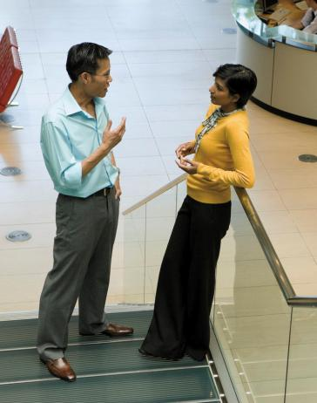
Learning Objectives
Technology
Procedure
Policies
Benefits
Notes:
What will the audience be able to do after this training is complete? Briefly describe each objective and how the audience will benefit from this presentation.

Slide 12
New Work
Notes:
Use a section header for each of the topics, so there is a clear transition to the audience.

Slide 13

New Work
The technology learning curve
Notes:
Add slides to each topic section as necessary, including slides with tables, graphs, and images.
See next section for sample table, graph, image, and video layouts.

Slide 14
Who’s Who
Lead | Contact information
Jim | Jim@company.com
Dee | Dee@gcompany.com
Mavis | Mavis@company.com
Doug | Doug@company.com
Notes:
Keep it brief. Make your text as brief as possible to maintain a larger font size.

Slide 15
Working Toward Mastery
Achieve Mastery
Get Experienced
Projects Worked On
Get Familiar
Time Spent

Slide 16

Doing Your Best Work
Working from home
Working offsite
Technology requirements
Notes:
If there is relevant video content, such as a case study video, demo of a product, or other training materials, include it in the presentation as well.

Slide 17

Case Study
Jeremy
  His first day
  Mistakes made
  Successes achieved
  The moral of the story
Notes:
Add a case study or class simulation to encourage discussion and apply lessons.

Slide 18
Discussion
What we can learn from Jeremy
Best practices
Take-aways
Notes:
Discuss outcomes of the case study or class simulation.
Cover best practices.

Slide 19
Summary
Define your challenges
  Technological as well as personal
Set realistic expectation
  Mastery is not achieved overnight
Keep your eye on the goal
  Mentorship programs
Notes:
Summarize presentation content by restating the important points from the lessons.
What do you want the audience to remember when they leave your presentation?

Slide 20
Resources
<Intranet site text here>
<hyperlink here>
<Additional reading material text here>
<hyperlink here>
This slide deck and related resources:
<hyperlink here>

Slide 21
Questions?

Slide 22
Appendix
Notes:
Is your presentation as crisp as possible? Consider moving extra content to the appendix.
Use appendix slides to store content that you might want to refer to during the Question slide or that may be useful for attendees to investigate deeper in the future.

