Slide 1

Test Construction and Making Item Analysis
Khad M. Layag
Chief Education Supervisor

Slide 2
Outline Presentation and activities
Test Construction
Item Analysis

Slide 3
Objectives:
Apply the principles of test construction in developing test items.
Apply the procedures of doing item analysis

Slide 4


Slide 5
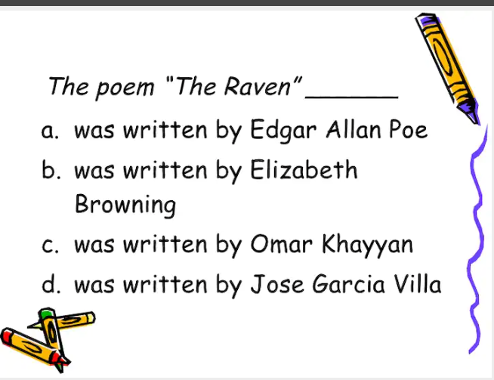

Slide 6


Slide 7


Slide 8
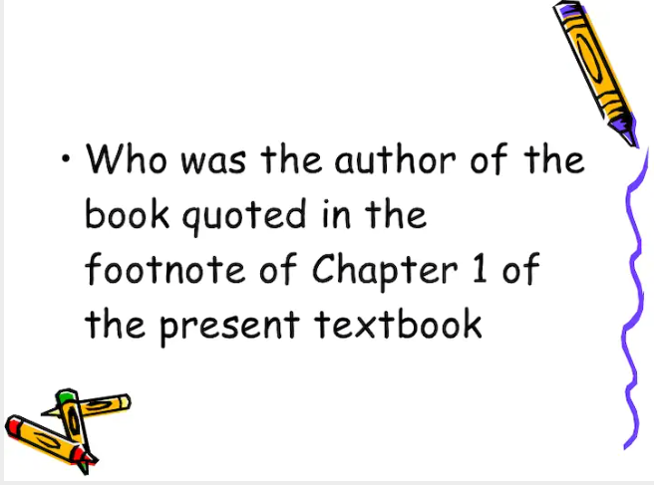

Slide 9


Slide 10


Slide 11
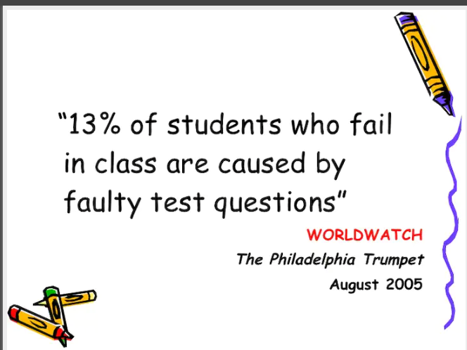

Slide 12
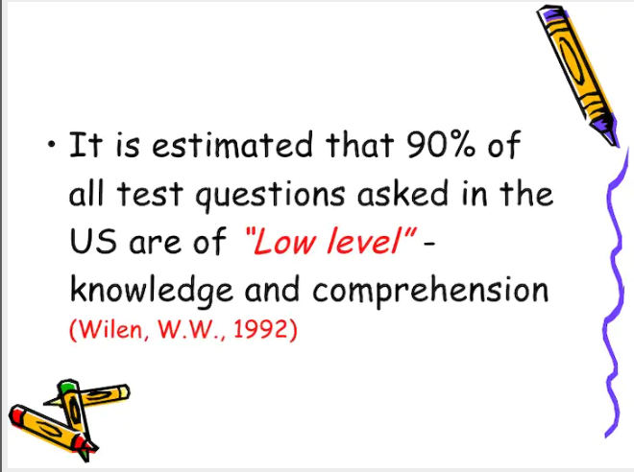

Slide 13
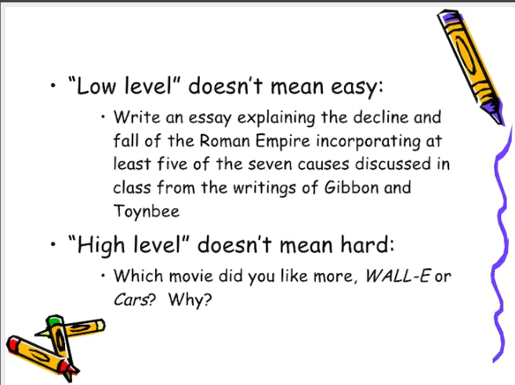

Slide 14


Slide 15
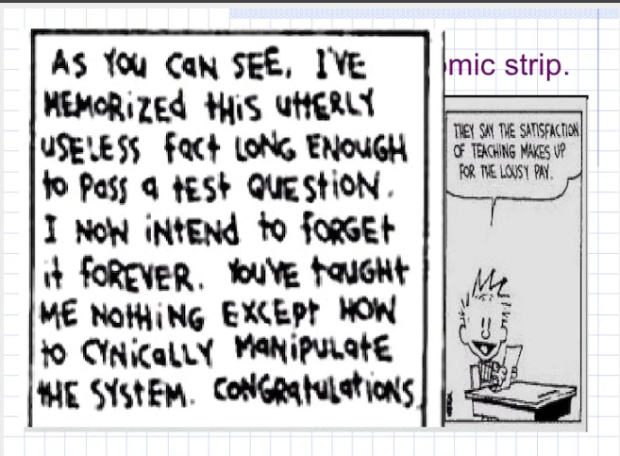

Slide 16


Slide 17


Slide 18
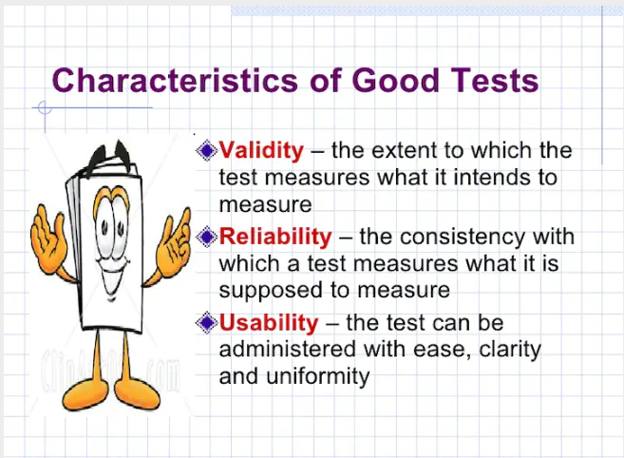

Slide 19
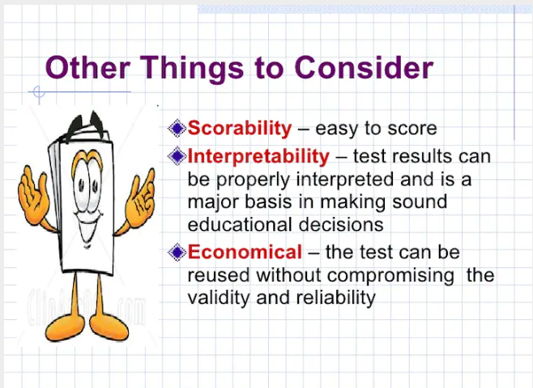

Slide 20
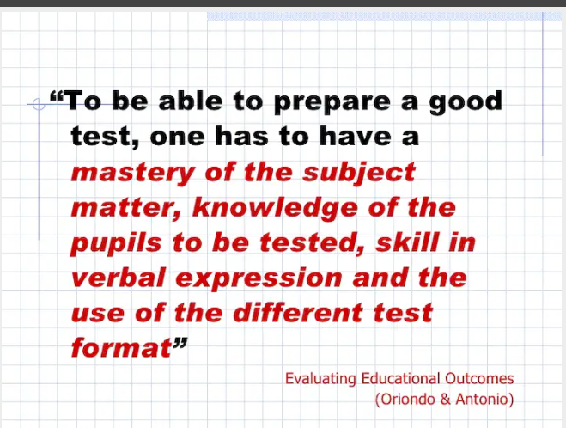

Slide 21
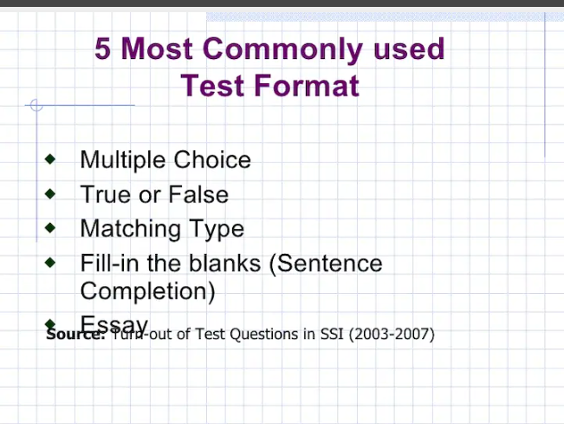

Slide 22
General Steps in Test Construction
Start
Prepare TOS
Draft
Order
End
Submit
Analyze
Test

Slide 23
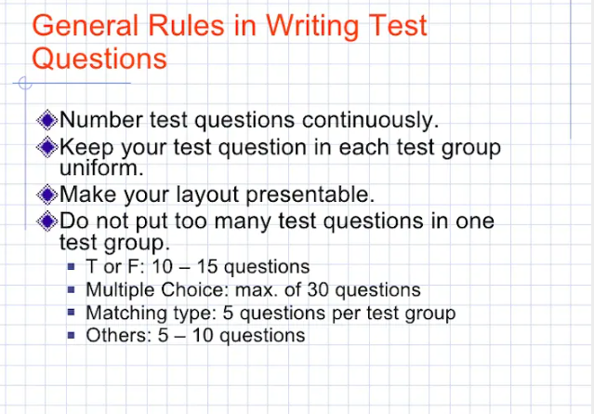

Slide 24
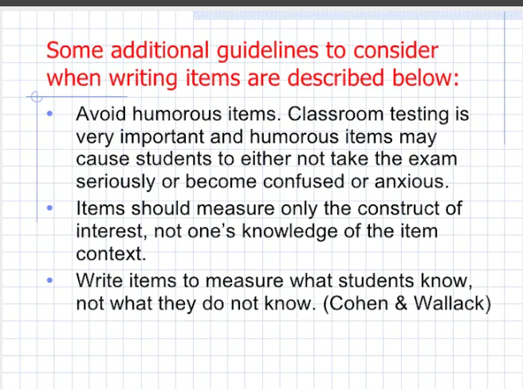

Slide 25
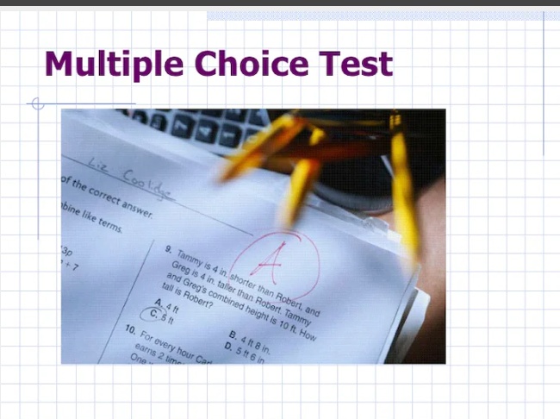

Slide 26
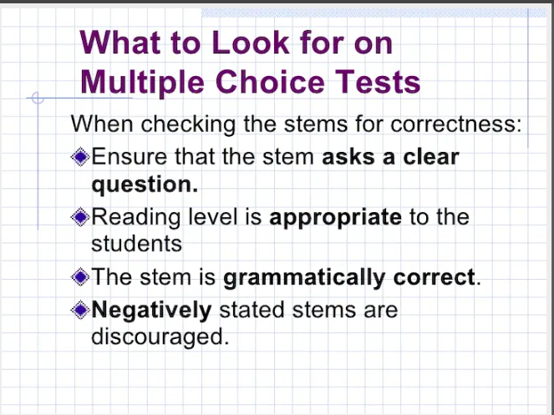

Slide 27
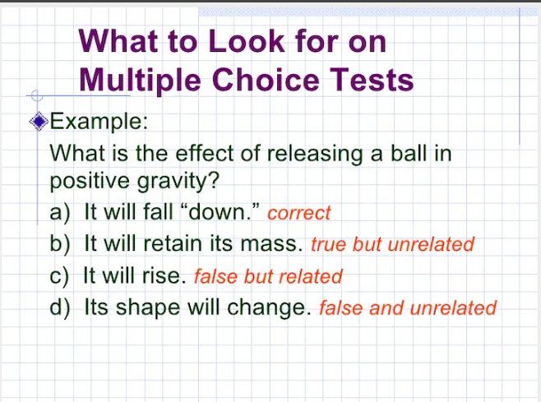

Slide 28
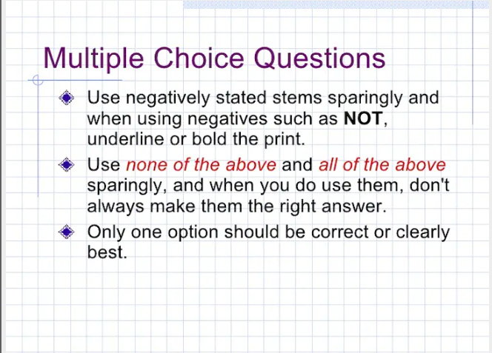

Slide 29
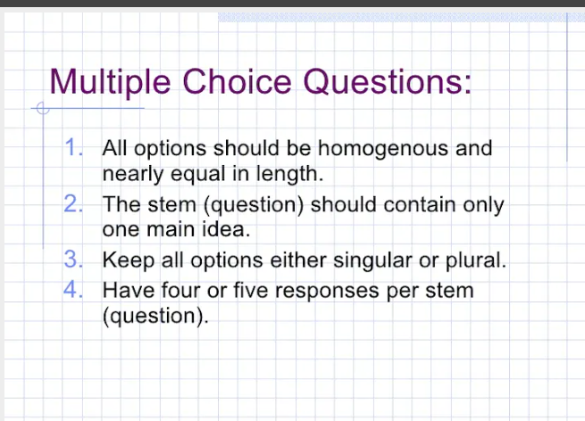

Slide 30
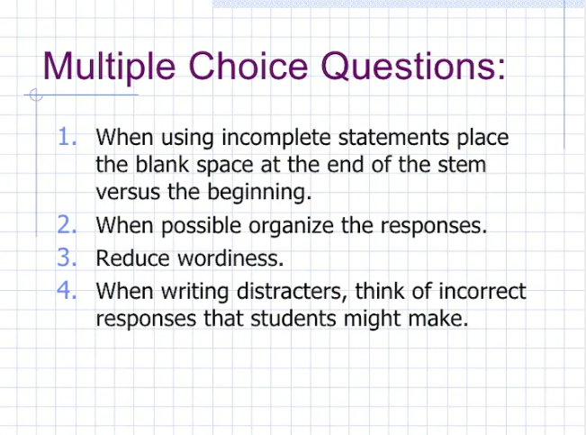

Slide 31
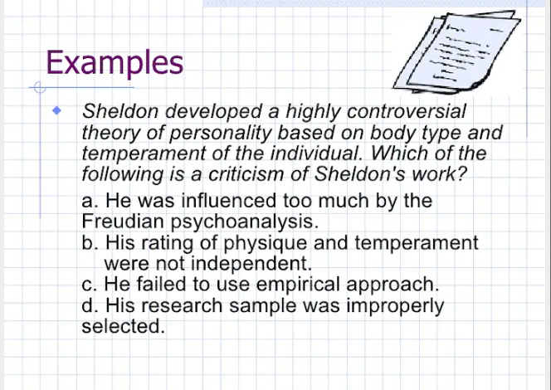

Slide 32
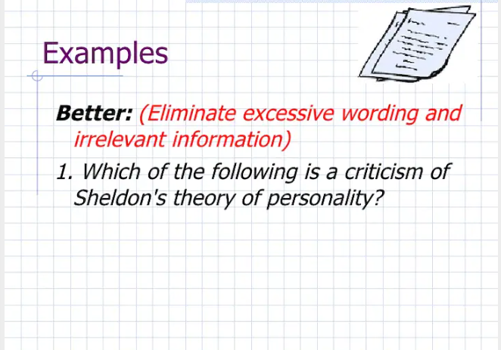

Slide 33
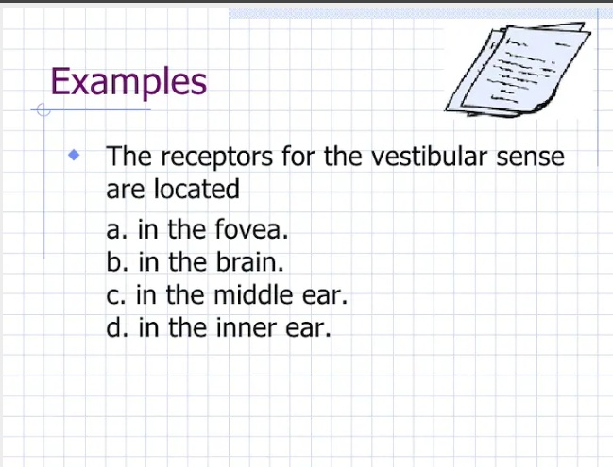

Slide 34
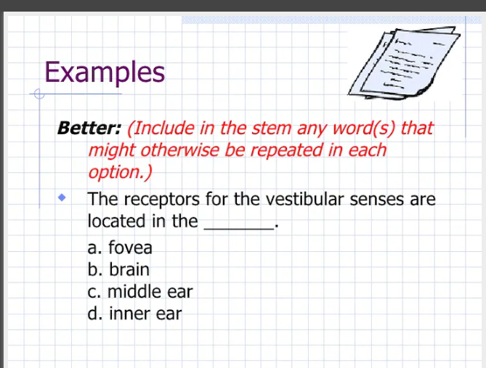

Slide 35
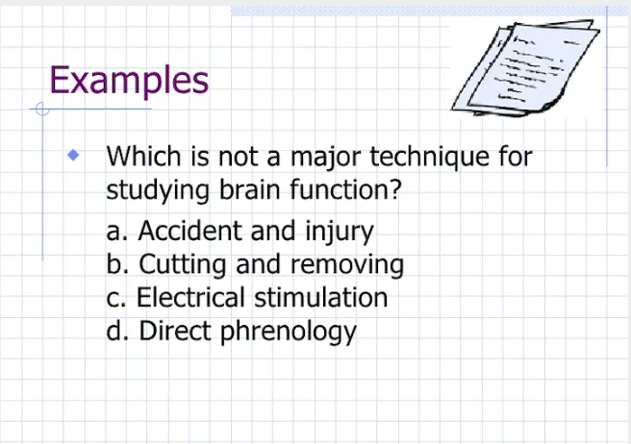

Slide 36
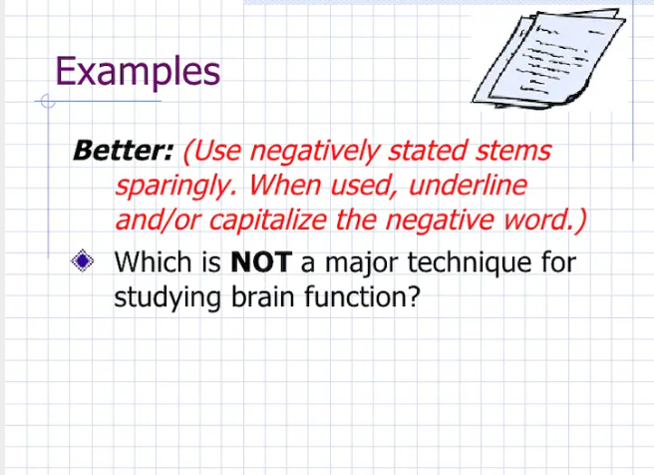

Slide 37
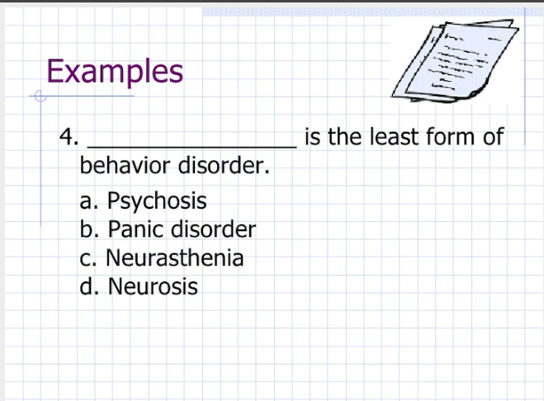

Slide 38
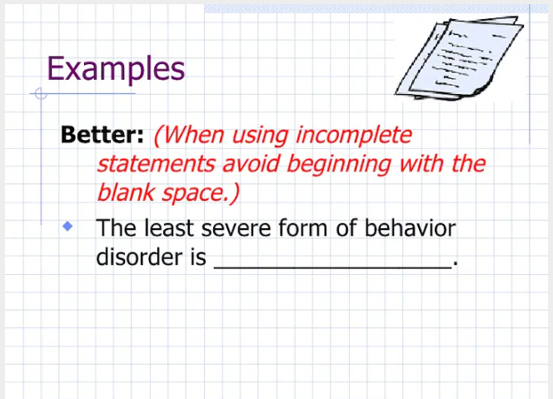

Slide 39
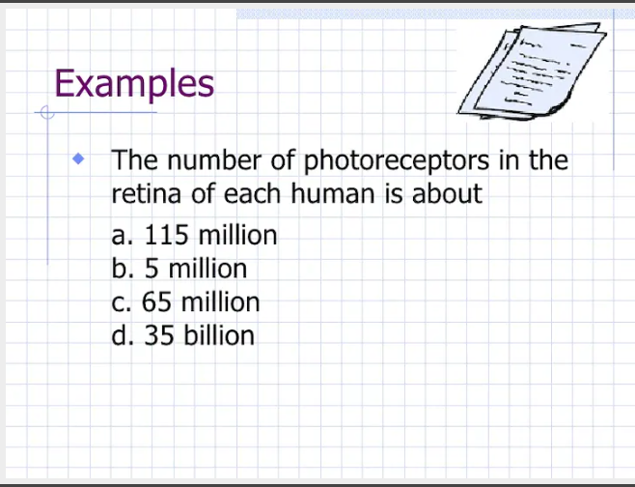

Slide 40
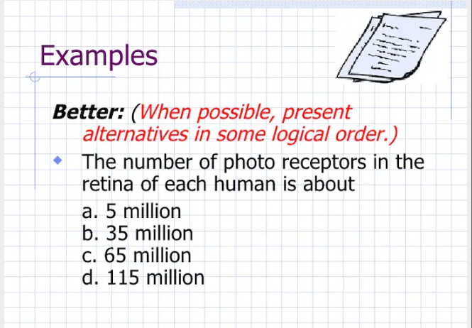

Slide 41
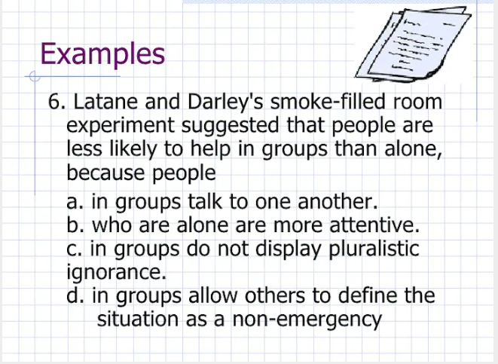

Slide 42
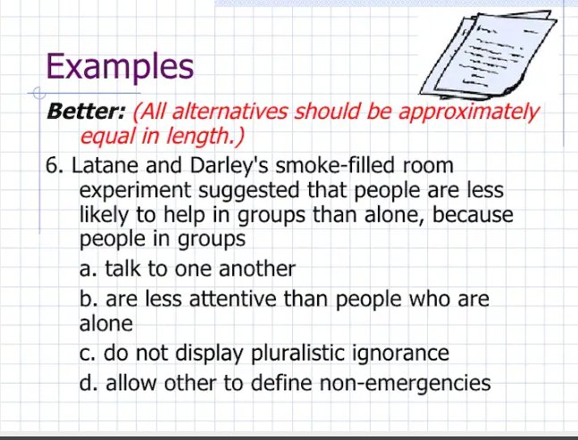

Slide 43
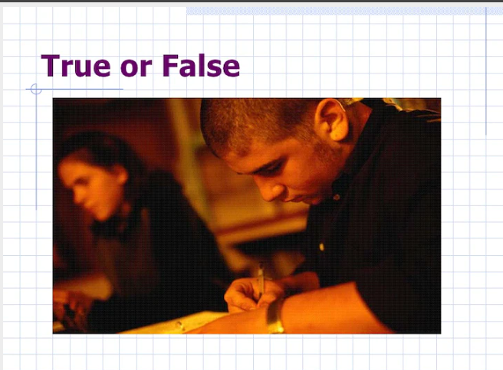

Slide 44
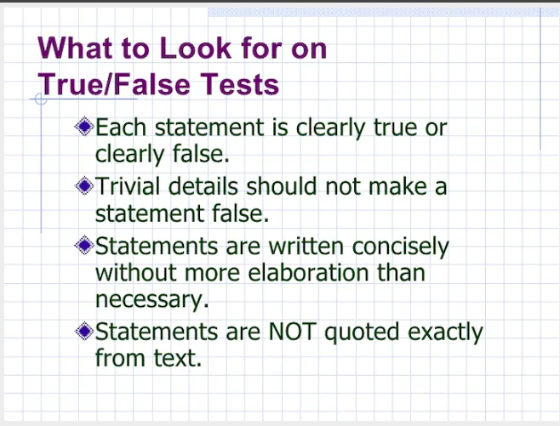

Slide 45
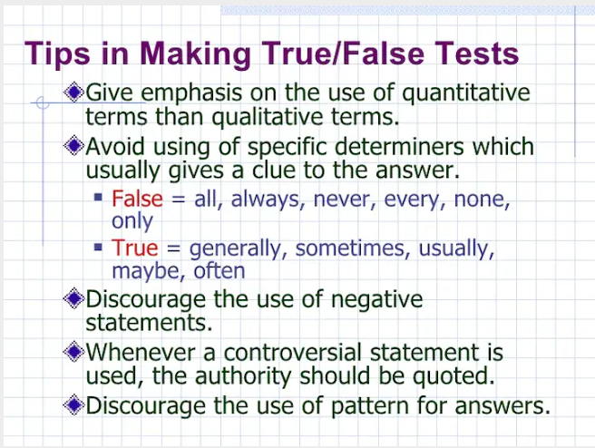

Slide 46
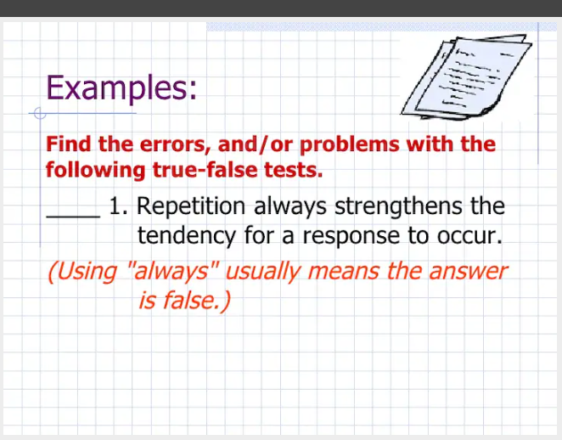

Slide 47
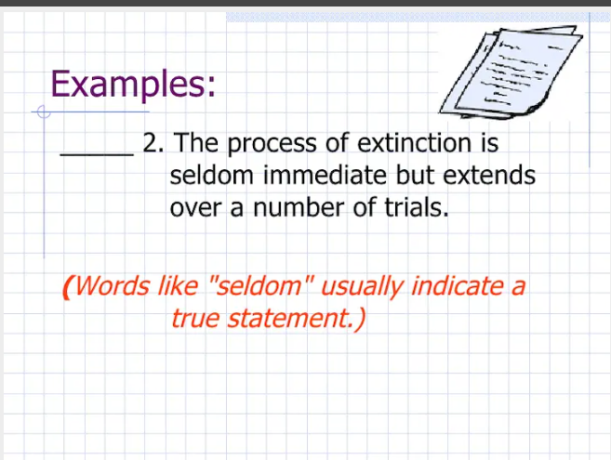

Slide 48
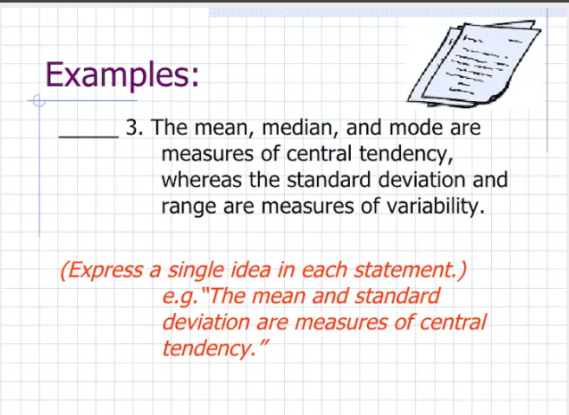

Slide 49
Reference:
http://www.slideshare.net/ArnelSSI

Slide 50
Workshop
Select a competency to be taught this second quarter.
Construct a multiple test item for the said competency applying the principles just learned.
Present your output for critiquing following this format:
Do your task for 30 minutes only
Objective:
Test Item:

Slide 51
Making Item Analysis the Conventional Way
Item Analysis: What is it?
Item analysis is a way of testing the effectiveness of test items. This is done by studying the learners’ responses to each item so as to get information concerning the following points:
  The difficulty of the item
  The discriminating power of the item
  The effectiveness of each item

Slide 52
Why conduct an Item Analysis
Information from item analysis can provide the teacher information whether an item is too easy or too difficult. It tells on how well an item discriminates between high and low achievers on the test. It tells further whether all the options functioned well.
Item analysis data also help in determining specific technical defect. Moreover, it gives information to be used for the improvement of the test items.

Slide 53
What are the benefits of item analysis?
It gives information for class discussion of the test. For instance, easy item can be treated lightly; responses to difficult items can be explained more comprehensively.
It gives data for helping the learners to improve their learning method. For instance, if a learner commits a number of incorrect responses to several items, this reveals misconceptions of the learning tasks, which should be taken into consideration for remedial work.
It gives insights and skills, which leads to the construction of better test items for future use.

Slide 54
Procedure in Making Item Analysis Using the U-L Method
Arrange the test scores from the highest to the lowest.
Separate the top 27% and the bottom 27% of the papers. The former is called the Upper Group (U) and the latter, Lower Group (L). Set aside the middle group.
Tally the responses made to each item by each individual in the upper 27% group.
Tally the responses made to each item by each individual in the lower 27% group.
Compute the percentage of the upper group that got the item right and call it PU.
Compute the percentage of the lower group that got the item right and call it PL.

Slide 55
7. Average PU and PL and the result is the difficulty index of the item.
Difficulty Index = (PU + PL)/2
Difficulty index is an index which indicates the percent of some specified group who answer a test item correctly.
8. Compute the discriminating power. In estimating the item discriminating power, simply compare the correct responses from the upper group and the correct responses from the lower group. Although analysis by inspection may be all that is necessary for most purposes, the index of discrimination can be easily computed by using the formula:
Index of Discrimination = PU - PL

Slide 56
Discriminating power is the ability of the test to distinguish between students having much and less of some traits. The maximum positive discriminating power of an item is 1.00. This is obtained only when all the upper group students choose the correct answer and not one in the lower group. Negative discriminating power is obtained when more students in the lower group got the right answers than the upper group. Moreover, a zero discriminating power is obtained when an equal frequency of the upper and lower groups get the correct answer.

Slide 57
9. Determine the effectiveness of the distracters. A good distracter attracts students in the lower group more than the upper group. The different options in the test must function as intended. If a particular option, which is not the correct answer was chosen by most of the respondents in the upper group more than the students in the lower group, the option is very attractive, yet confusing. Moreover, if a particular option was not chosen by at least 3% f the students (both from the upper and lower groups), the option is non-plausible and unattractive. It is obviously not the correct answer. These kinds of options must be carefully looked into.

Slide 58
Plausible distracter as used in measurement and evaluation refers to the reasonableness of each of the possible choices, which are included in an item of multiple-choice type.
For example:
He is a corrupt public official. Corrupt means ______.
A. bankrupt B. correct C. develop D. dishonest
C is not a plausible answer because the word “develop” belongs to a different part of speech. All the other choices are adjectives while develop is a verb. A student who possesses an adequate knowledge of parts of speech will surely not choose C. Thus, his vocabulary knowledge is not really tested.

Slide 59
Evaluation Criteria for Discrimination and Difficulty Items
A. Difficulty Index
Difficulty Level | Description Level | Recommendation
0.91 – 0.76 | Easy | Not acceptable but could include just one or two, revise or discard others
0.75 – 0.26 | Moderately Difficult | Very Acceptable (include all)
0.25 - below | Very Difficult | Include only one or two, discard or revise others

Slide 60
B. Discrimination Index
Discrimination Level | Description Level | Recommendation
0.41 and above | High | Very Acceptable (include all)
0.20 – 0.40 | Moderate | Acceptable (include all)
0.19 - below | Low | Limited in Acceptability (include or discard others)

Slide 61
C. Criteria for Item Category
Item Category | Criteria
Good | If acceptable in 3 criteria: Difficulty – 0.20 – 0.75 Discrimination – 0.20 – above Option – chosen by at least 3% of the total respondents
Fair | If acceptable in 2 criteria: Either Difficulty/Discrimination, Difficulty/Option or Discrimination/Option
Poor | If acceptable in only one criterion Not acceptable in 3 criteria

Slide 62
Practice Exercise
Item No. | Group | Distracters |  |  |  |  | PU | PL | Diff. Index | Disc. Index | Qualitative Evaluation
 |  | A | B | C | D | Omit |  |  |  |  | 1 | 2 | 3 | 4 | Decision
1 | U | 4 | 35 | 1 | 2 | 0 | .83 | .36 | .60 | .47 | MD (VA) | H (VA) | OK | Good | Retain
 | L | 5 | 15 | 7 | 14 | 1
2 | U | 2 | 21 | 14 | 5 | 0
 | L | 8 | 11 | 18 | 5 | 0
3 | U | 13 | 0 | 24 | 5 | 0
 | L | 26 | 7 | 7 | 2 | 0
4 | U | 24 | 2 | 13 | 3 | 0
 | L | 14 | 4 | 13 | 11 | 0
5 | U | 6 | 36 | 0 | 0 | 0
 | L | 18 | 16 | 6 | 2 | 0
6 | U | 2 | 21 | 6 | 13 | 0
 | L | 7 | 11 | 15 | 10 | 0
7 | U | 8 | 0 | 31 | 3 | 0
 | L | 7 | 7 | 21 | 7 | 0

Slide 63
Legend:
PU – Percentage of upper group who go the item correctly
PL – Percentage of lower group who got the item correctly
MD – Moderately Difficult
D – Difficult
LA – Limited in Acceptability
      L – Low
Qualitative Evaluation
1 – Difficulty Index
2 – Discrimination Index
3 – Options
4 - Category

Slide 64
Let’s Check our Practice Exercise
Item No. | Group | Distracters |  |  |  |  | PU | PL | Diff. Index | Disc. Index | Qualitative Evaluation
 |  | A | B | C | D | Omit |  |  |  |  | 1 | 2 | 3 | 4 | Decision
1 | U | 4 | 35* | 1 | 2 | 0 | .83 | .36 | .60 | .47 | MD (VA) | H (VA) | OK | Good | Retain
 | L | 5 | 15 | 7 | 14 | 1
2 | U | 2 | 21* | 14 | 5 | 0 | .5 | .26 | .28 | .24 | MD (VA) | M (A) | OK | Good | Retain
 | L | 8 | 11 | 18 | 5 | 0
3 | U | 13 | 0 | 24* | 5 | 0 | .57 | .17 | .37 | .4 | MD (VA) | M (A) | Revise C | Good | Retain but revise C
 | L | 26 | 7 | 7 | 2 | 0
4 | U | 24* | 2 | 13 | 3 | 0 | .57 | .33 | .45 | .24 | MD (VA) | M (A) | OK | Good | Retain
 | L | 14 | 4 | 13 | 11 | 0
5 | U | 6 | 36* | 0 | 0 | 0 | .86 | .38 | .62 | .48 | MD (VA) | H (VA) | Revise D | Fair | Retain but revise D
 | L | 18 | 16 | 6 | 2 | 0
6 | U | 2 | 21 | 6* | 13 | 0 | .14 | .36 | .25 | -.22 | D (LA) | L (LA) | OK | Poor | Discard
 | L | 7 | 11 | 15 | 10 | 0
7 | U | 8* | 0 | 31 | 3 | 0 | .19 | .17 | .18 | .02 | D (LA) | L (LA) | Revise B | Poor | Discard
 | L | 7 | 7 | 21 | 7 | 0

Slide 65
Reference:
Geronimo Jr. R. Salem, A Handbook in Making Item Analysis (Conventional), Nueva Vizcaya: Saint Mary’s University, November 12-15,2003.

Slide 66
Thank you very much!

